Slide 1

Predicting The Risk of Defaulting Against Credit Risk Variables
Group 9: Sabah Javaid, Augustin Nare and Iftikar Ahmed
Kaggle Dataset: https://www.kaggle.com/rameshmehta/credit-risk-analysis
GitHub Link: https://github.com/iftahmed/STA-9891-Project
Notes:
Good Evening everyone! We hope you are all doing well.
Our project is based on the Credit Risk Analysis dataset which can be found on Kaggle. We are focused on predicting the risk of defaulting against other credit risk related variables.
Before we discuss our implementation of the 4 modelling techniques: Ridge, Lasso, Elastic Net and Random Forest. We would like to give more insight on our data.

Slide 2
Data Description
Dataset: Credit Risk Analysis(Kaggle)
Response Variable: default_ind
The original number of features: p = 73 while sample size equated to n = 855,969
After cleaning and organizing the data, we were left with p = 38 and n = 1000
Imbalance Ratio: 17.7%
N(+)= 177
N(-)= 745
Predictors: loanamnt, annual_inc, grade, installments, etc.
Notes:
A brief description of the nature of the data, motivation and why it's important to analyze this data. Here we should understand why the data is important, how it was collected, what is the imbalance, what is n; p, the imbalance ratio, and what are the features. (1 slide)
“Credit Risk is the possibility of a loss resulting from a borrower's failure to repay a loan or meet contractual obligations. Traditionally, it refers to the risk that a lender may not receive the owed principal and interest, which results in an interruption of cash flows and increased costs for collection.”
Using the credit risk analysis dataset from Kaggle, we try to predict the credit risk before a borrower defaults on their loan
Saying this our response variable is known as the default indicator, which is a binary variable that holds a value of 1 when a borrower defaults on their loan and 0 otherwise
Our Original data had 73 parameters and a sample size of 65,535
After cleaning the data and setting our analysis to a smaller sample size, we are left with 38 parameters and a sample size of 1000
The imbalance ratio:177 cases of defaults, 745 cases of non-defaulted loans
Goal: Predict defaulted loans against other credit risk factors.

Slide 3
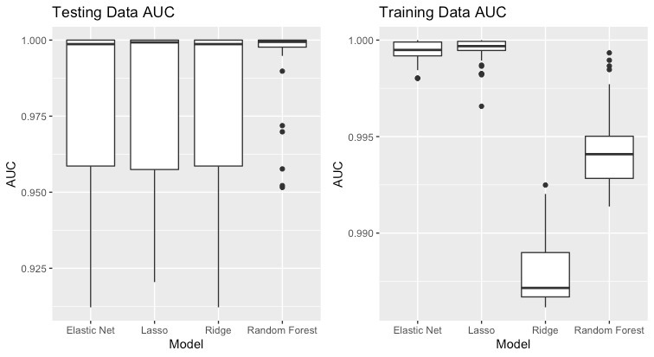
Boxplots: AUC of 50 samples
Notes:
We randomly split the data between the train and test subset where the test subset data has 900 observations, and the train has 100 observations respectively.
When looking at the side-by-side boxplots we noticed that:
the AUC values are higher in the test subset compared to the train subset data.
In addition, the AUC variances (bigger boxes) in the test subset data are larger than that of the train. This holds to be true for the Elastic Net, Lasso and Ridge of the test subset compared to the training subset. However, in the case of the random forest test. It can be see that the variance is larger in the training data subset compared to the testing data.
In terms of prediction, The AUC for the Lasso out-performs the other regression methods at approximately 97% in the train data subset.
However in the Test data subset, the AUC values for both Elastic Net and Ridge perform similar to one another at approximately 96%. Both Regression methods are out-performed by the lasso and Random Forest.
While the random forest is the only test that possess a few outliers in the Test data Subset, in the train data all four regression methods possess at least 1 outlier.

Slide 4
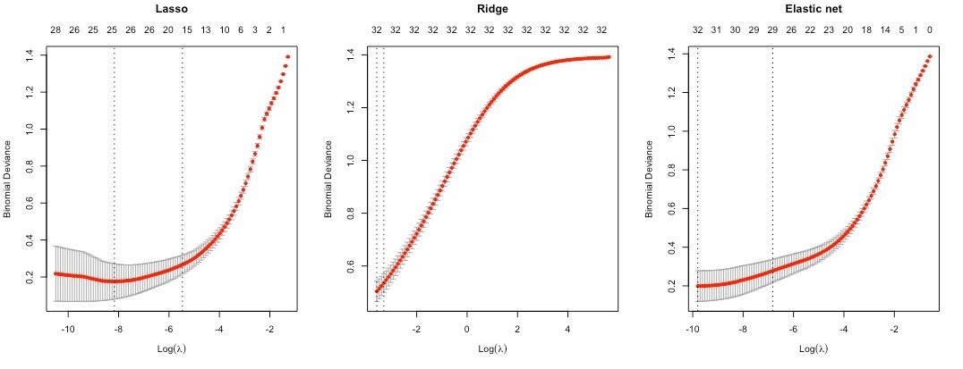

10-Fold Cross Validation Curves

Slide 5
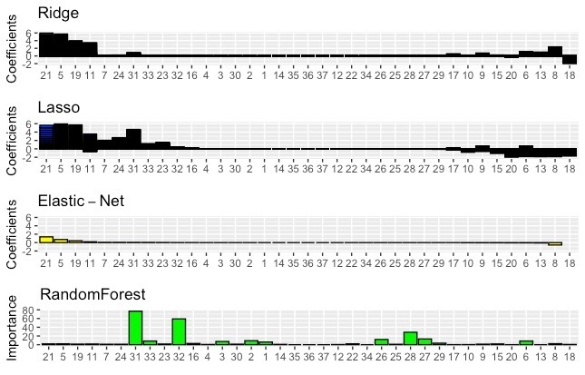
Bar Plots of Estimated Coefficients
Notes:
Present bar-plots of the standardized estimated coefficients (lasso, ridge, elastic-net), the importance of the parameters. Note that the graphs must be such that we can clearly see the differences. The idea is to see if these three statistical learning methods agree more or less on which features are important or not. Specifically, use the elastic-net estimated coefficients to1 create an order based on largest to smallest coefficients. Use this order to present the estimated coefficients of lasso and ridge. Also use the same order to present the variable importance of random forest.
So in the end, we want to see a figure, with 4 X1 subplots, each corresponding to the bar plots of the estimated coefficients (and variable importance).
Say a few words about the most important predictors that are positively and negatively associated with the response. Is there any insight here to share? (1 slide)

Slide 6

Fitting Time & Performance
Model | Median Testing AUCS | Time (CV parameter tuning + fitting the model)
Ridge | 0.9986727 | 7.46
Lasso | 0.9992535 | 1.33
Elastic Net | 0.9986727 | 4.78
Random Forest | 0.9994214 | 1.05
*** The AUC medians of the Lasso and Random Forest are the greatest, respectively.
*** Ridge and Elastic Net have the same results in testing median AUC however Ridge had a longer runtime in comparison to Elastic net.
*** Random Forest has the largest AUC value while its runtime was the shortest.
Notes:
Is there a trade-off between the time it takes to train a model and it's predictive performance?

Slide 7
Closing Remarks
Two largest coefficients for El-Net, Lasso and Ridge
(positive):
Revolving Balance
Interest Rate
(negative):
Last 6 months inquiries
sub grade
Two most important variables for Random Forest model:
collection recovery fee
recoveries
Conclusion:
While all four models (Lasso, El-Net, Ridge and Random Forest) show very high levels of test AUC, the Random Forest is valued the highest.
In addition, the runtimes range from 1.05 to 7.46 seconds.
Regression method that fits the data the best and was high performing:
Random Forest with a runtime of 1.05 seconds.
Notes:
We should focus on which regression method fits the data the best and which data was high performing and most accurate? Compare best fit runtime in words compared to better performing method.

